Slide 1
INSURANCE ANALYTICS project
Group Members
Varad Patil
Rohit Marathe
NM Yajna
Joycee Adhav
Sreenivas Bhosale
Aarya Sangle

Slide 2
Data Overview
Data Sources: Six interconnected Excel datasets:
Brokerage & Fees: Core revenue streams.
Individual Budgets: Target benchmarks for Account Executives.
Invoices: Transactional records of billed revenue.
Meetings: Sales activity and engagement tracking.
Opportunities: Sales pipeline and potential future revenue.
Scope: Data spans multiple branches (e.g., Ahmedabad) and various insurance product groups (Marine, Fire, Employee Benefits).

Slide 3
Technical Process
Data Cleaning (Excel): Standardizing date formats and handling null values in the 6 source files.
Database Management (SQL): Using JOIN and UNION ALL to combine Brokerage and Fees for a unified revenue view.
Business Logic: Calculating "Achieved vs. Target" metrics using window functions and aggregations.
Visualization (Power BI/Tableau/Excel):
Power BI:. For interactive filtering by Branch and Executive
Tableau: For deep-dive trend analysis and geographical performance.
Excel: For quick pivot-based KPI summaries.

Slide 4
Objectives & Key KPIs
The project focuses on measuring success through six primary KPIs:
Total Revenue vs. Target: Measuring the gap between achieved Brokerage/Fees and set Budgets.
New vs. Renewal Business: Tracking the ratio of fresh client acquisition to retained business.
Meeting Productivity: Quantifying the relationship between client meetings and successful conversions.
Opportunity Pipeline Value: Total estimated revenue sitting in "Qualify," "Negotiate," and "Propose" stages.
Executive Performance: Ranking Account Executives by invoice count and revenue generated.
Cross-Sell Achievement: Evaluating the success of selling additional products to existing clients.

Slide 5
Analysis & Findings
Revenue
Mix
Pipeline
Health
Top
Performers
Analysis shows a heavy reliance on "Renewal" income, with a significant opportunity to grow "New" and "Cross-Sell" segments.
The "Opportunity" data indicates a high volume of deals in the "Qualify" stage ($5.9M+) but a drop-off in the "Negotiate" stage ($899k), suggesting a need for better closing strategies.
Executives like Gilbert and Ketan Jain lead in invoice counts, while others show high meeting activity but lower conversion rates.

Slide 6
Recommendations & Insights
Focus on Conversion: Shift executive training from "Lead Generation" to "Closing" to move the $5.9M in "Qualify" opportunities through the funnel.
Incentivize Cross-Selling: Since Cross-Sell targets show high variance, introduce specific bonuses for solution groups like "Construction" or "Marine" for existing clients.
Activity-Based Management: Use the "Meeting" data to set a minimum weekly meeting threshold for underperforming executives.

Slide 7
Challenges & Learning
Data Silos: Combining "Brokerage" and "Fees" into a single revenue view required complex SQL unions due to different column structures.
Data Integrity: Handling mismatched "Account Executive IDs" across different tables to ensure accurate reporting.
Learning: Gained expertise in "Multi-Tool Integration"—understanding when to use SQL for heavy lifting vs. Power BI for storytelling.

Slide 8
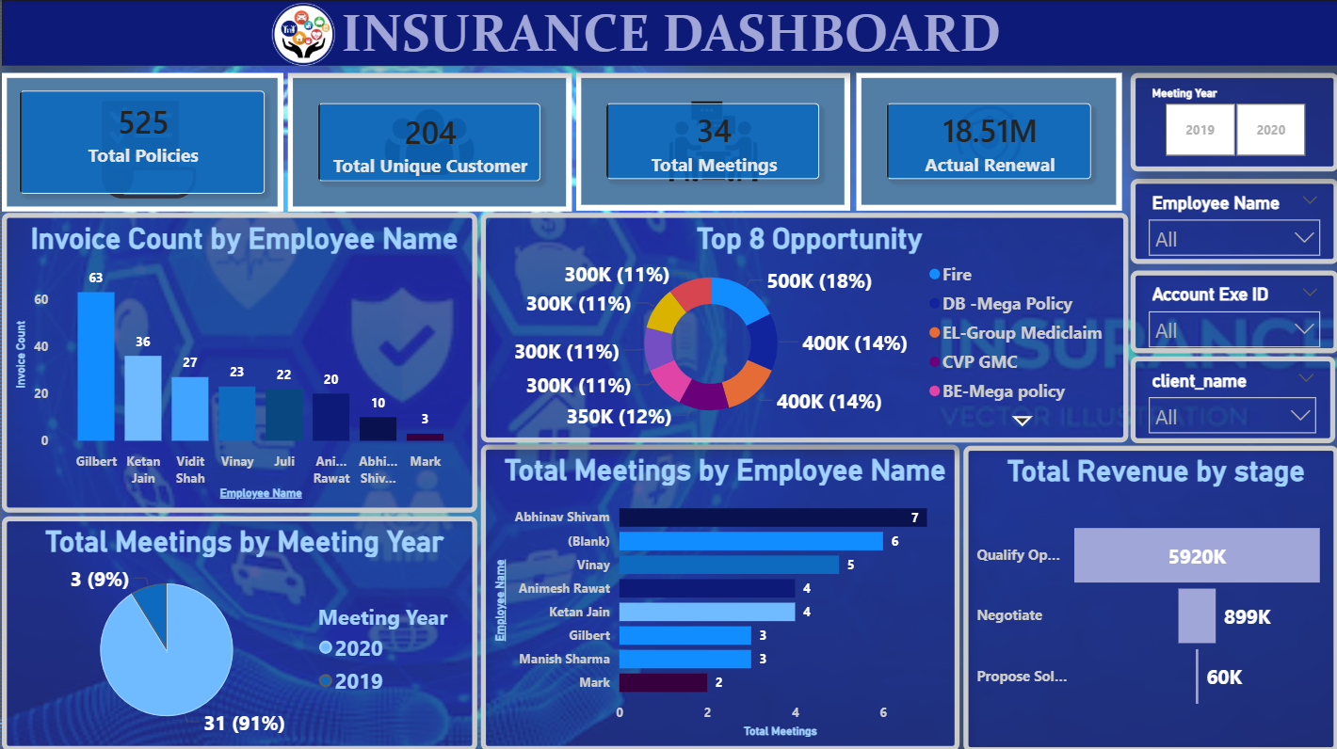

Slide 9
Conclusion
The project successfully integrated fragmented data into a unified reporting system.
The transition from manual Excel tracking to automated Power BI/Tableau dashboards reduces reporting time by approximately 70%.
Final Thought: Data is only as good as the decisions it inspires. These dashboards now provide the roadmap for the next fiscal year.

Slide 10
THANK YOU

